Slide 1
Rockbuster Stealth Data Analysis
Yeji Chun

Slide 2
OBJECTIVE&GOALS
Which movies contributed the most/least to revenue gain?
What was the average rental duration for all videos?
Which countries are Rockbuster customers based in?
Where are customers with a high lifetime value based?
Do sales figures vary between geographic regions?

Slide 3
CURRENT STANDING
Total Count of Films | 1000
Total Count of Customers | 599
Total Count of Countries | 109
Total Revenue | 61312.04

Slide 4
RENTAL DURATION
Minimum Rental Duration | Maximum Rental Duration | Average Rental Duration
3 | 7 | 4.985
Rental Duration average for 1000 films were 4.985, which is approximately 5 days.

Slide 5
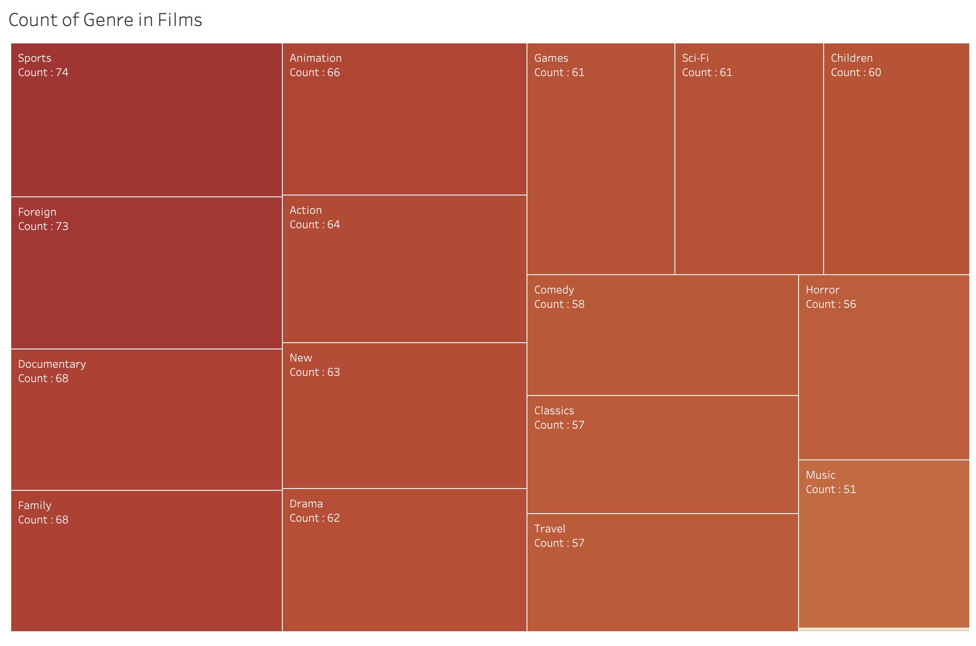
COUNT OF GENRE
This shows the total count of each Genre for all the films. Sports, Foreign, Family and Documentary are the most common Genre. Thriller only has 1 film.

Slide 6
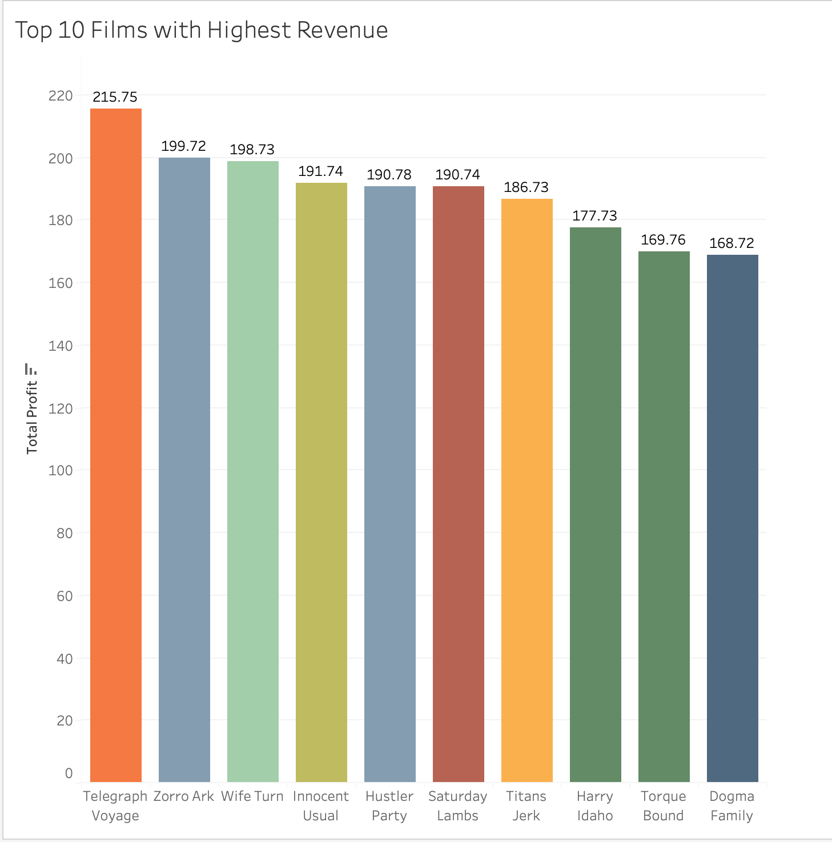
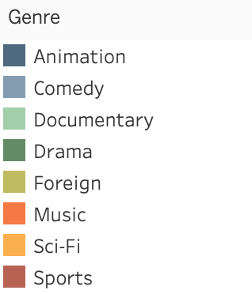
FILMS WITH HIGHEST REVENUE
The film with highest revenue was the “Telegraph Voyage”.
This film is the only film in the top 10 list that is a music genre.
Most common genre seen is comedy and drama.

Slide 7
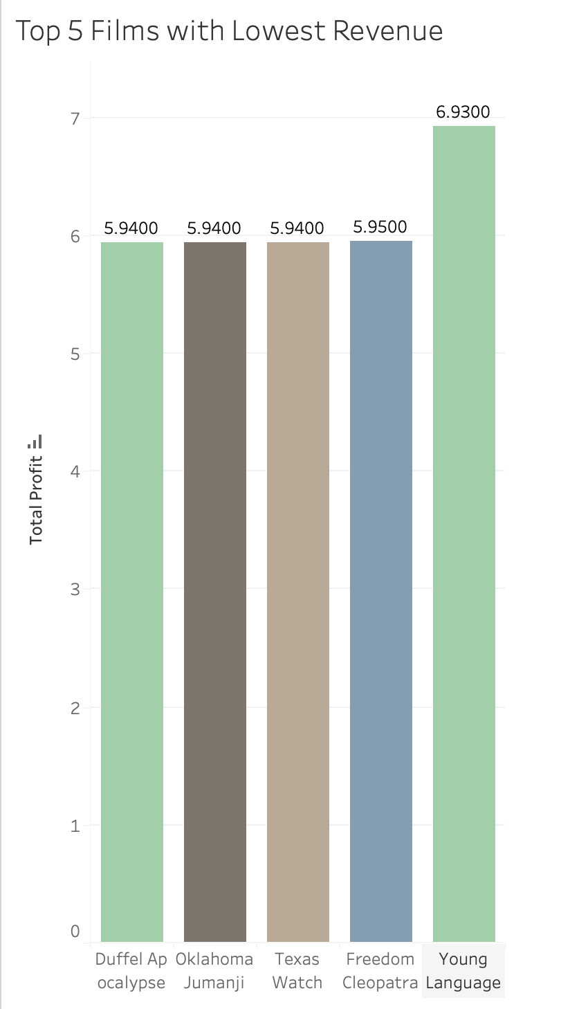
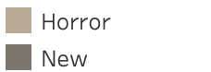
FILMS WITH LOWEST REVENUE
The film with lowest revenue was the “Duffel Apocalypse”
Documentary is the most common genre with the lowest revenue.
Horror and New are also genre that were not so popular.

Slide 8
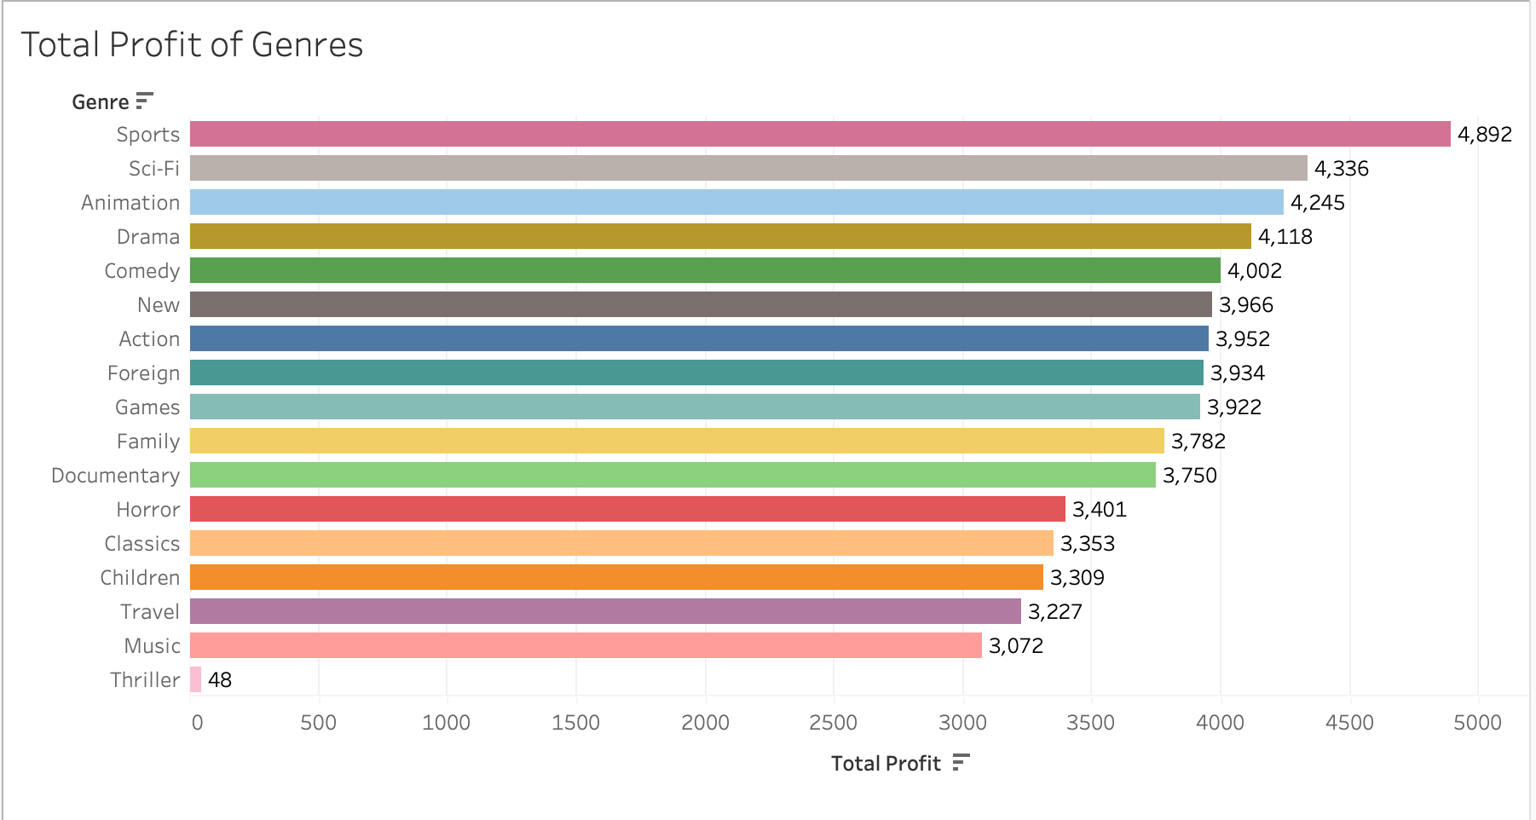
GENRES WITH TOP REVENUE
Genre with the highest revenue are Sports, Sci-Fi and Animation. This differs from the most common Genre seen in the previous slide.

Slide 9
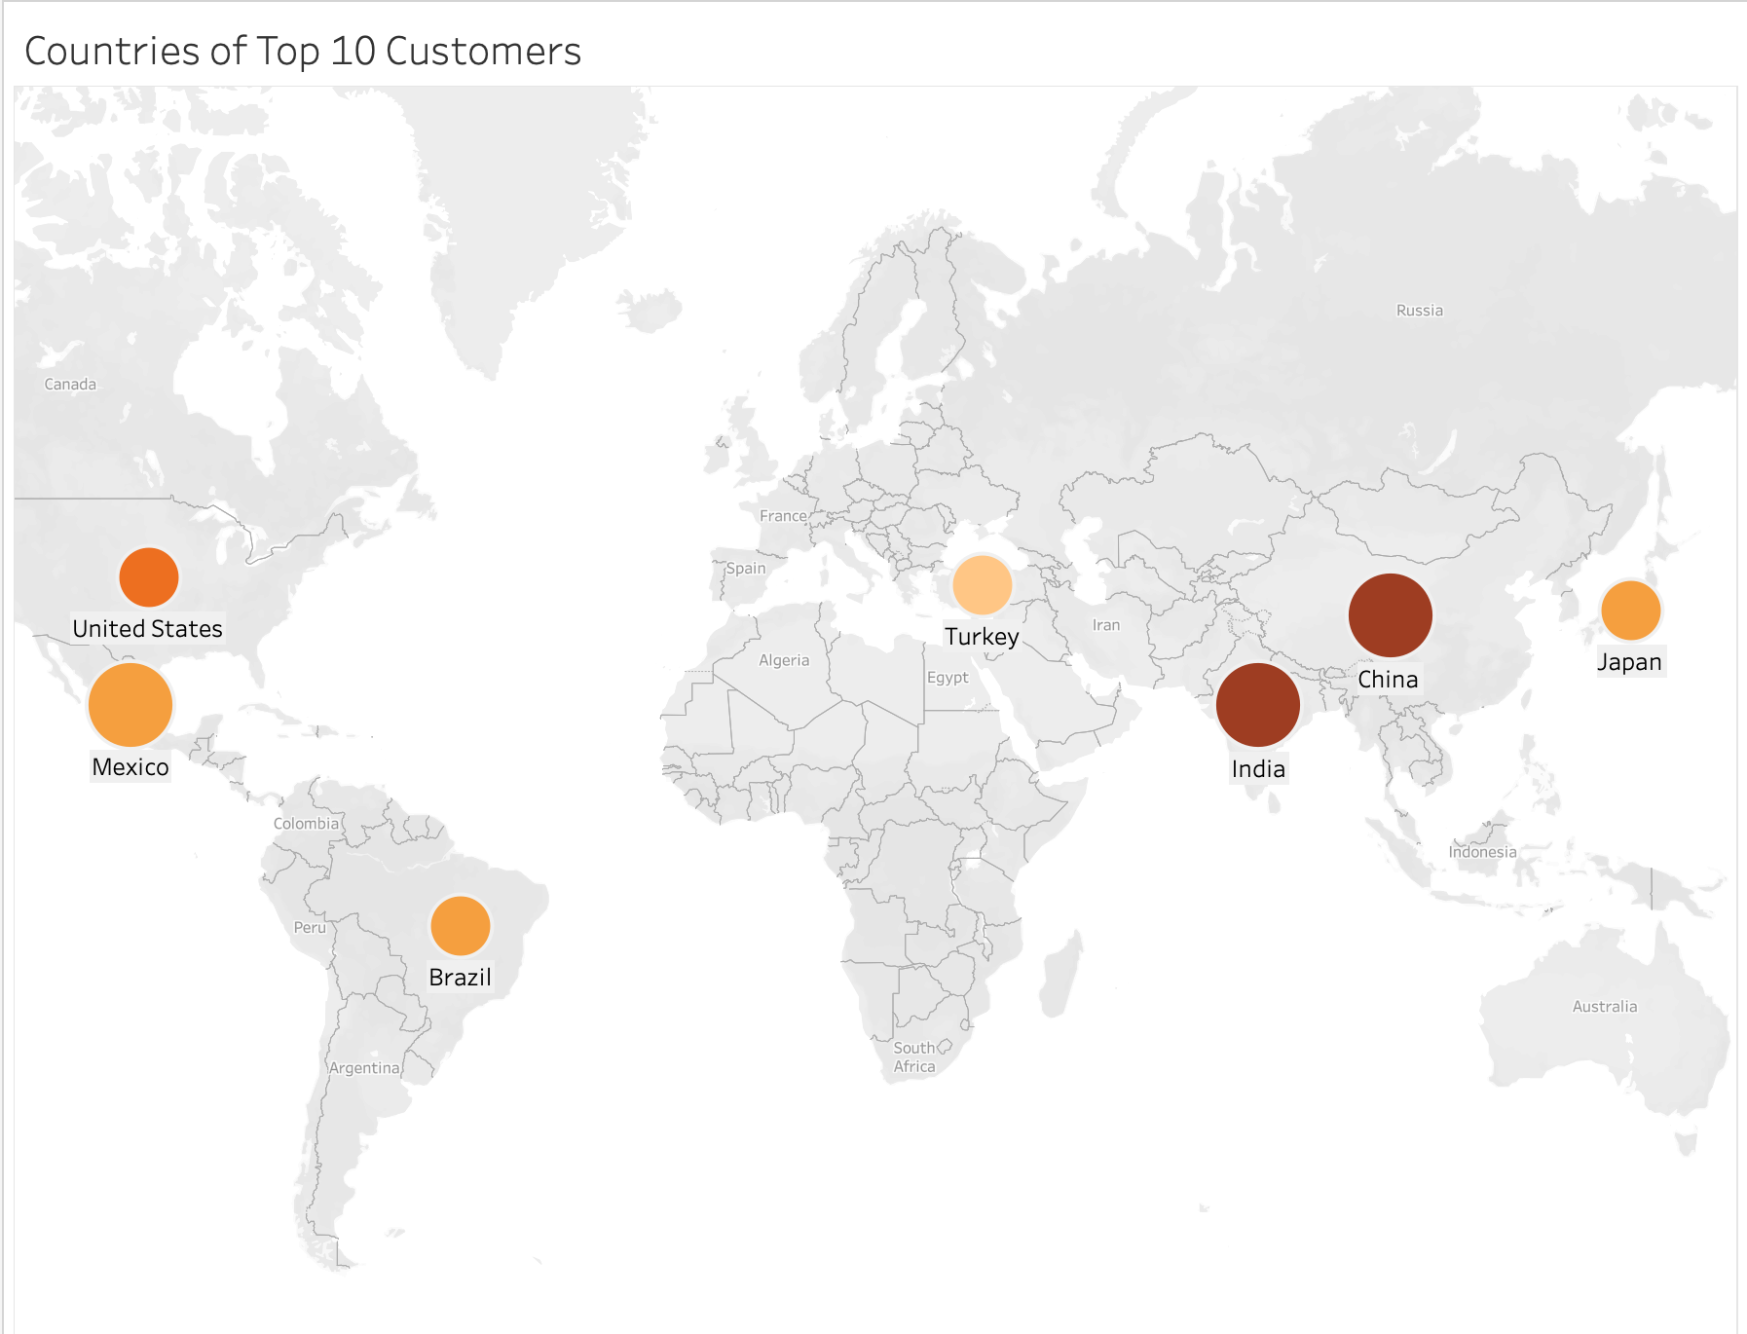
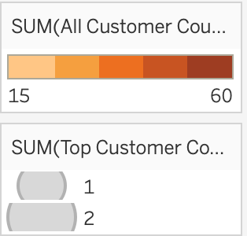
MAP OF TOP 10 CUSTOMERS’ LOCATIONS
As seen in the map, Top 10 customers are located mostly in Mexico, India, and China, which are locations with higher number of total customers as well.

Slide 10
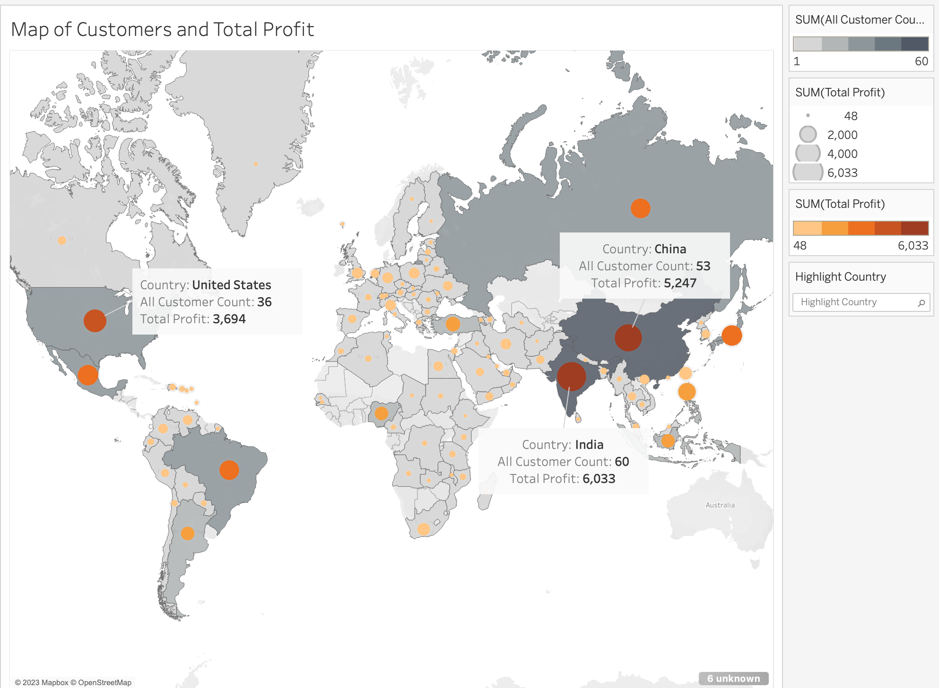
MAP OF ALL CUSTOMERS AND TOTAL PROFIT
This map shows the locations of all the customers in gray. Darker gray being more populated and lighter being less. The orange circle shows total profit with darker shade being higher profit. This map illustrates that countries with higher number of customers also shows higher total profit.

Slide 11
CONCLUSION&RECOMMENDATION
Sports, Sci-fi and Animation are the highest earning genre but not the most common genre in stock. More investment should be made on these genres.
Comedy and Drama are the common genres seen in films with highest revenue so these genre should be invested in as well.
India, China and United States are the highest earning countries. More advertisement and promotion should be made in stores within these countries.

Slide 12
REFERENCES
Tableau public links
Slide 5 - https://public.tableau.com/app/profile/yeji.chun/viz/Rockbustercharts/Genre?publish=yes
Slide 6 - https://public.tableau.com/app/profile/yeji.chun/viz/Rockbustercharts-highestrevenue/Highestrevenue?publish=yes
Slide 7 - https://public.tableau.com/app/profile/yeji.chun/viz/Rockbustercharts-lowestrevenue/lowestrevenue?publish=yes
Slide 8 - https://public.tableau.com/app/profile/yeji.chun/viz/Rockbustercharts-topprofitofgenres/TopGenrebasedonRevenue?publish=yes
Slide 9 - https://public.tableau.com/app/profile/yeji.chun/viz/Rockbustercharts-countriesoftopcustomers/top10country?publish=yes
Slide 10 - https://public.tableau.com/app/profile/yeji.chun/viz/Rockbustercharts-allcustomermap/Mapofcustomerandprofit?publish=yes

